Slide 1


SQL INTERNSHIP
RAMPRABHU.G
DEC’2023
End-End Project:PIZZA SALES DATA ANALYSIS

Slide 2
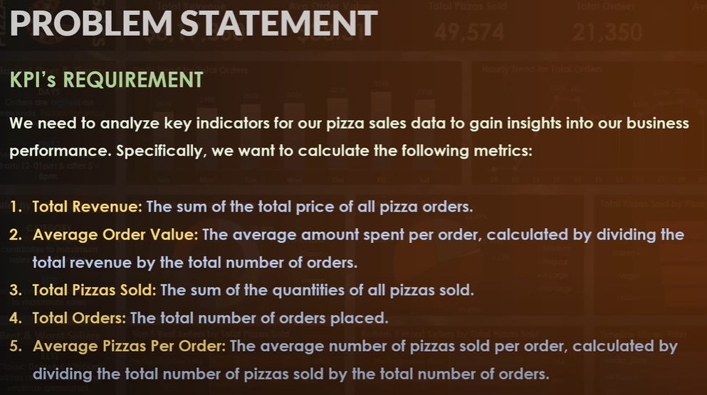
CUSTOMER KPI
01 - BRANDING
02 - WEBSITE
03 - SOCIAL MEDIA

Slide 3
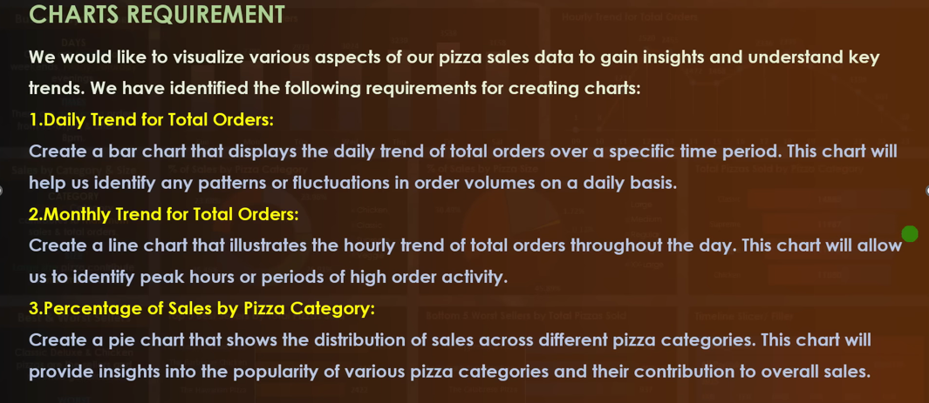
CUSTOMER KPI
01 - BRANDING
02 - WEBSITE
03 - SOCIAL MEDIA

Slide 4
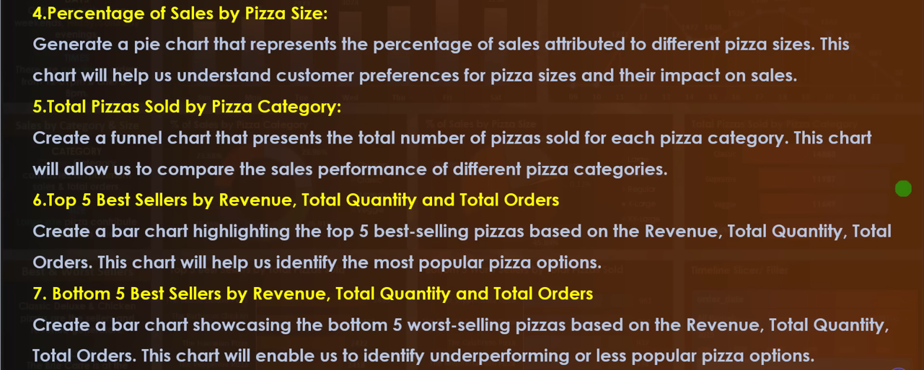
CUSTOMER KPI
01 - BRANDING
02 - WEBSITE
03 - SOCIAL MEDIA

Slide 5

OBJECTIVE:
Create New Data base in MS-SSMS SQL server
TASK→Import Data in database and Upload the MS-Excel data in MS-SSMS
Refresh the Database
Table will automatically inserted
Start writing the query as per Customer KPI
01 - BRANDING
02 - WEBSITE
03 - SOCIAL MEDIA

Slide 6
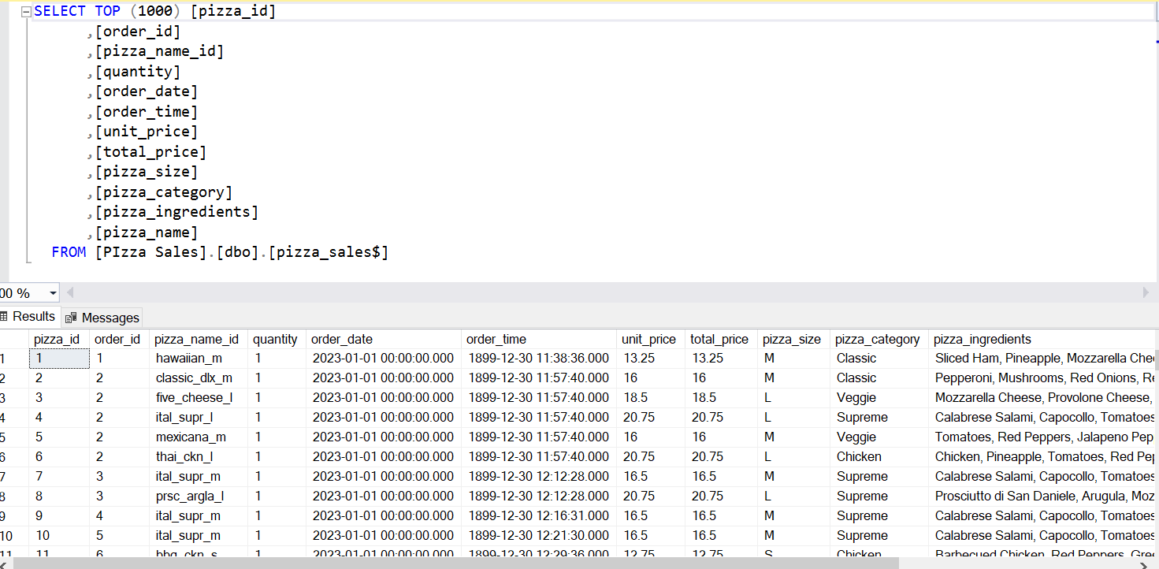
1.Select Top 1000 Rows from Table.
01 - BRANDING
02 - WEBSITE
03 - SOCIAL MEDIA

Slide 7
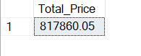
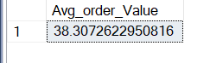
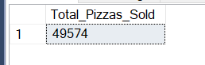
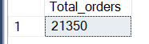
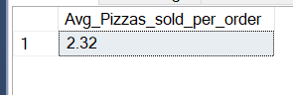
KPI Requirements:.
01 - BRANDING
02 - WEBSITE

Slide 8
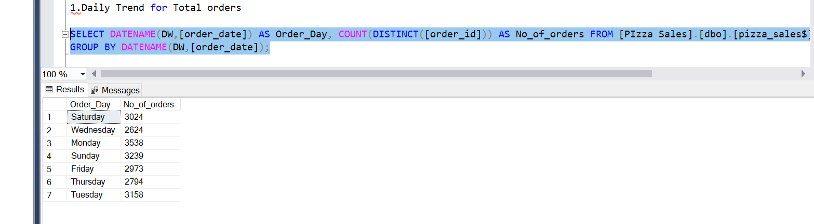
Visualization and Chart Requirements:.

Slide 9
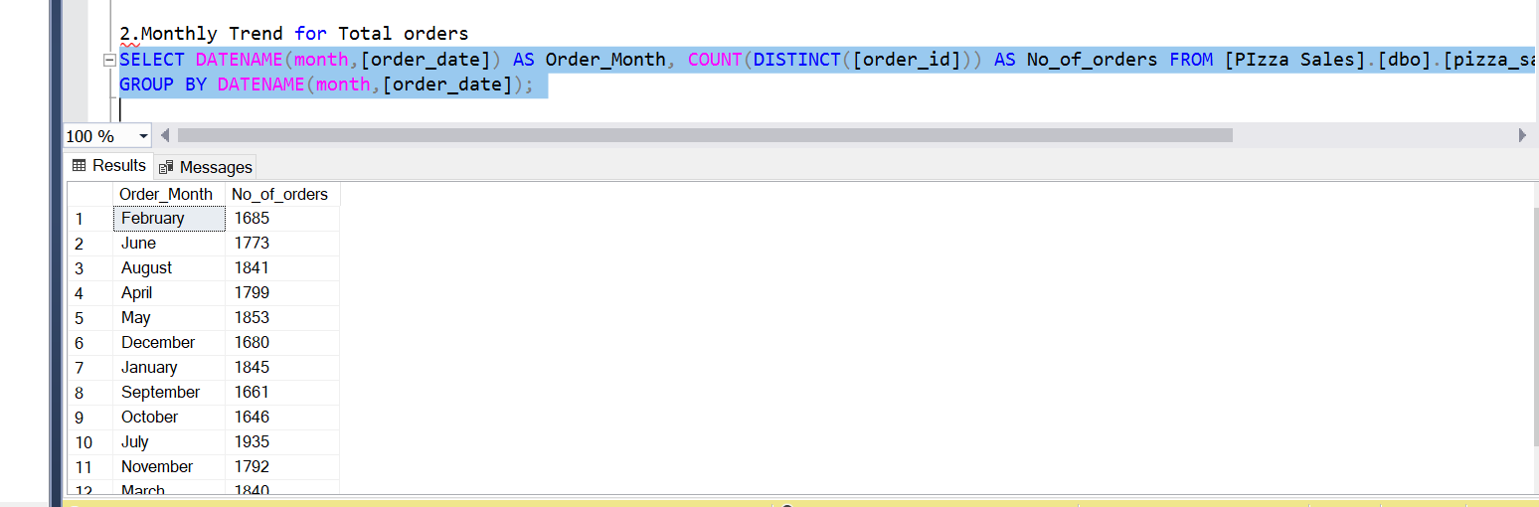
Visualization and Chart Requirements:.

Slide 10
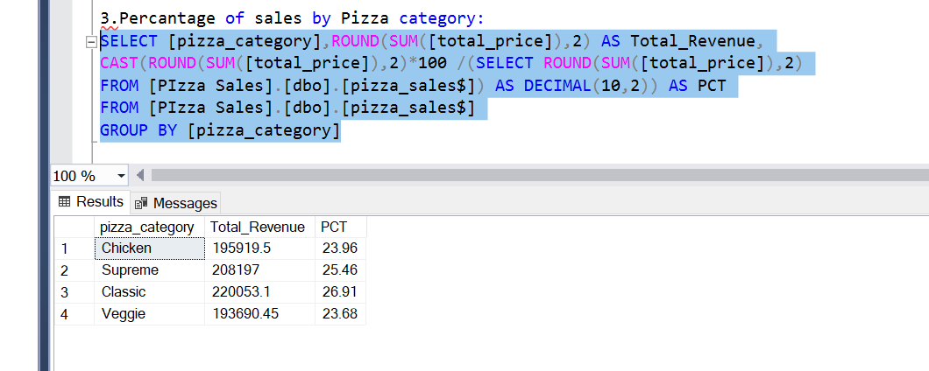
Visualization and Chart Requirements:.

Slide 11
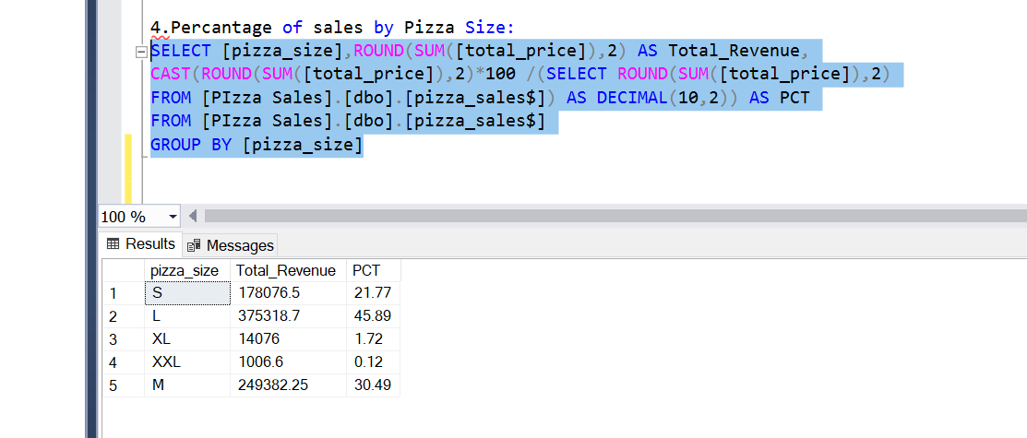
Visualization and Chart Requirements:.

Slide 12
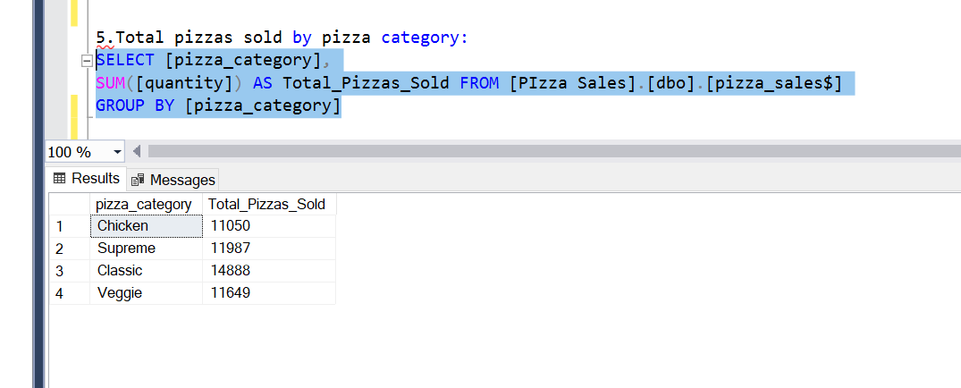
Visualization and Chart Requirements:.

Slide 13
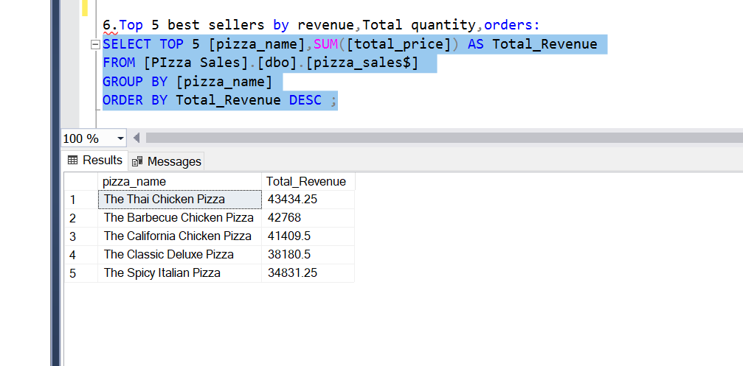
Visualization and Chart Requirements:.

Slide 14
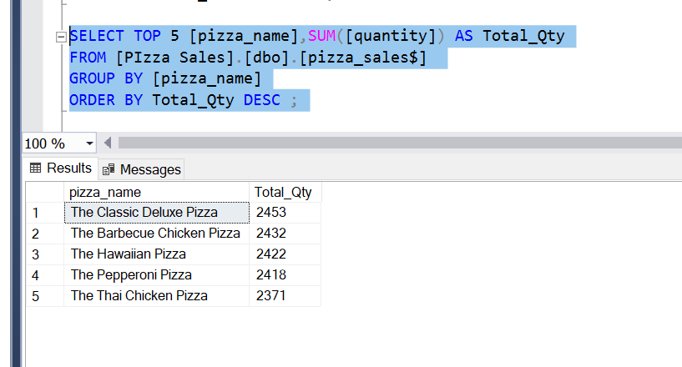
Visualization and Chart Requirements:.

Slide 15
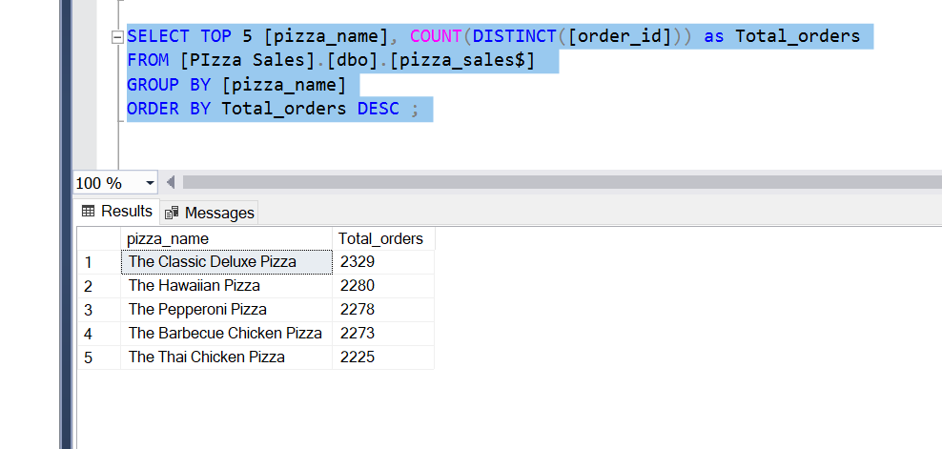
Visualization and Chart Requirements:.

Slide 16
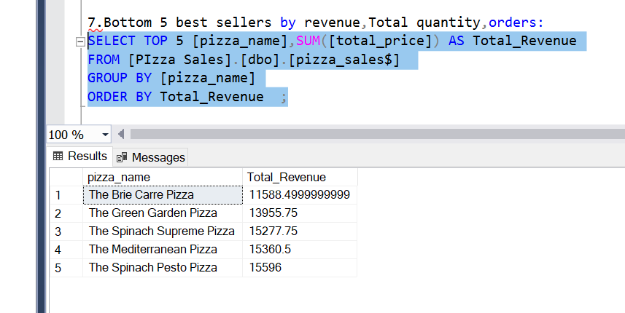
Visualization and Chart Requirements:.

Slide 17
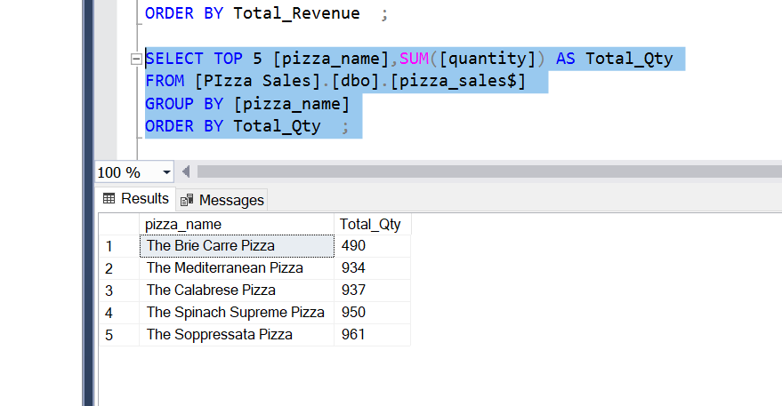
Visualization and Chart Requirements:.

Slide 18
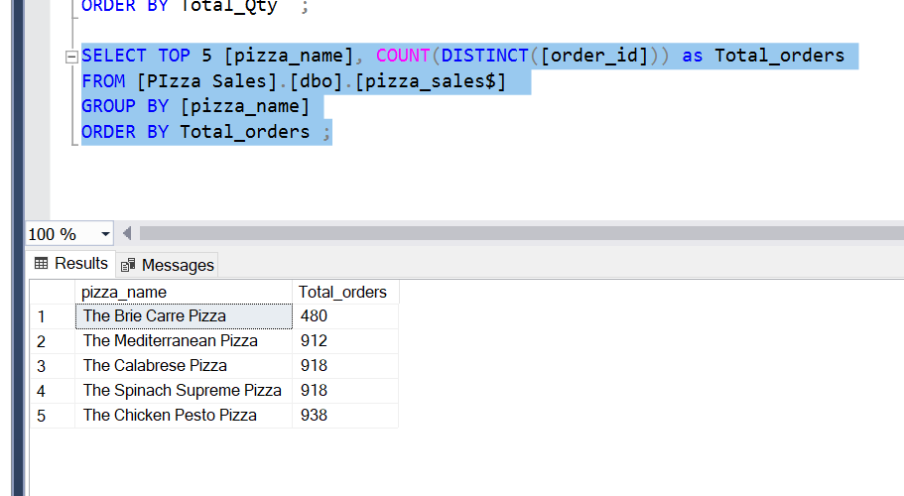
Visualization and Chart Requirements:.

Slide 19
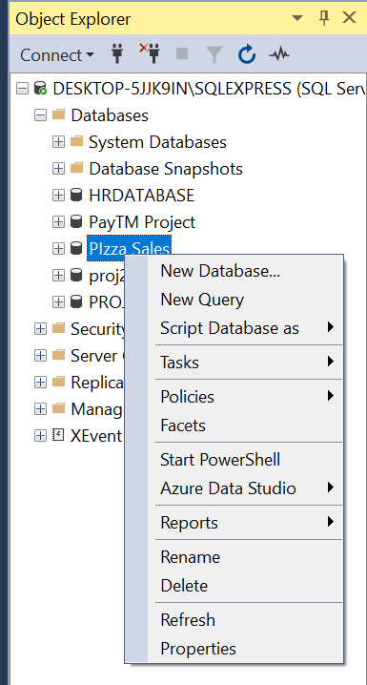
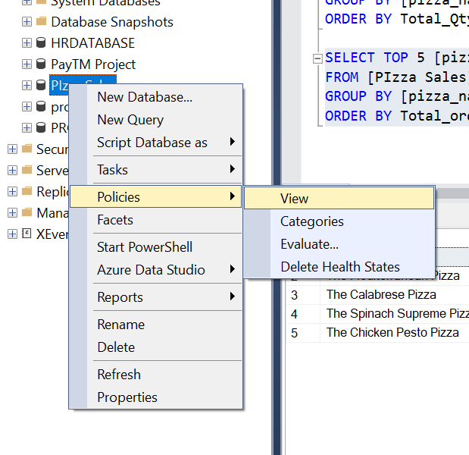
SSMS TO POWER BI :
RIGHT CLICK AND SELECT POLICIES
SELECT POLICIES AND GO TO VIEW

Slide 20
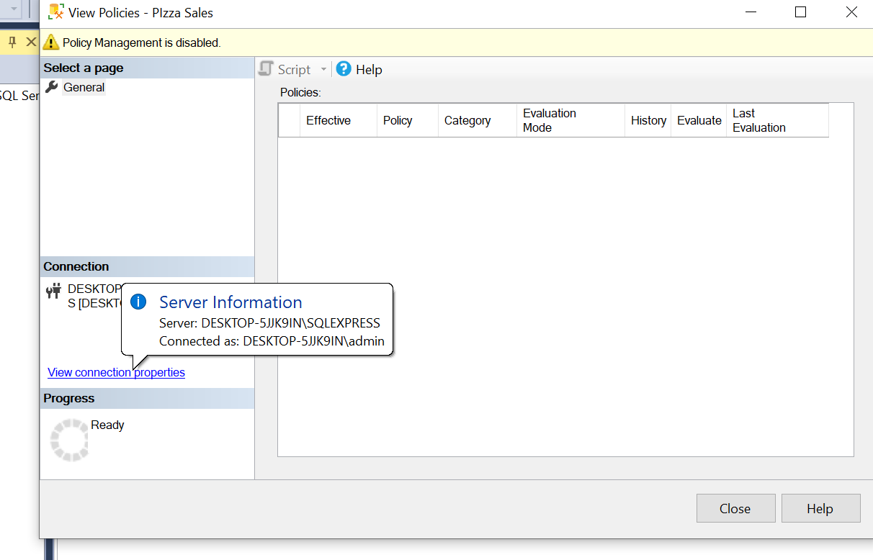
SSMS TO POWER BI :
SELECT VIEW CONNECTION PROPERTIES

Slide 21
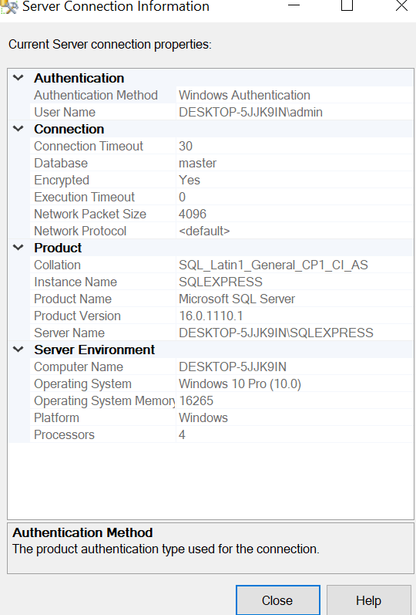
SSMS TO POWER BI :
COPY THE SERVER NAME AND PASTE INTO POWERBI SQL SERVER

Slide 22
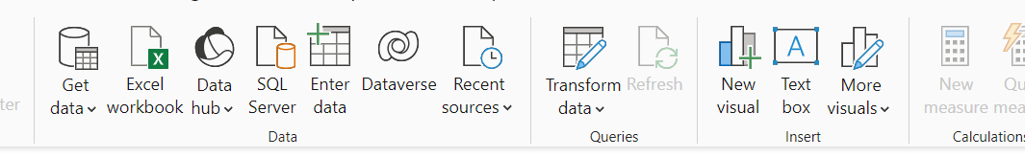
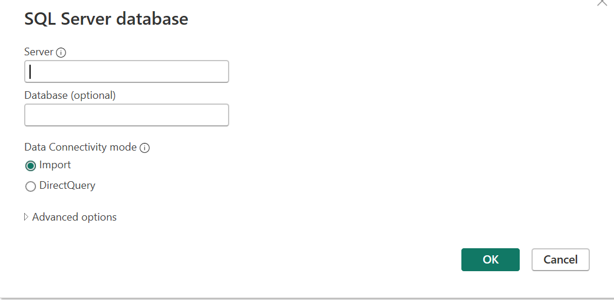
Select the server
Select the server
SSMS TO POWER BI :
Paste the copied
Server name from SSMS SQL
Paste the copied
Server name from SSMS SQL

Slide 23
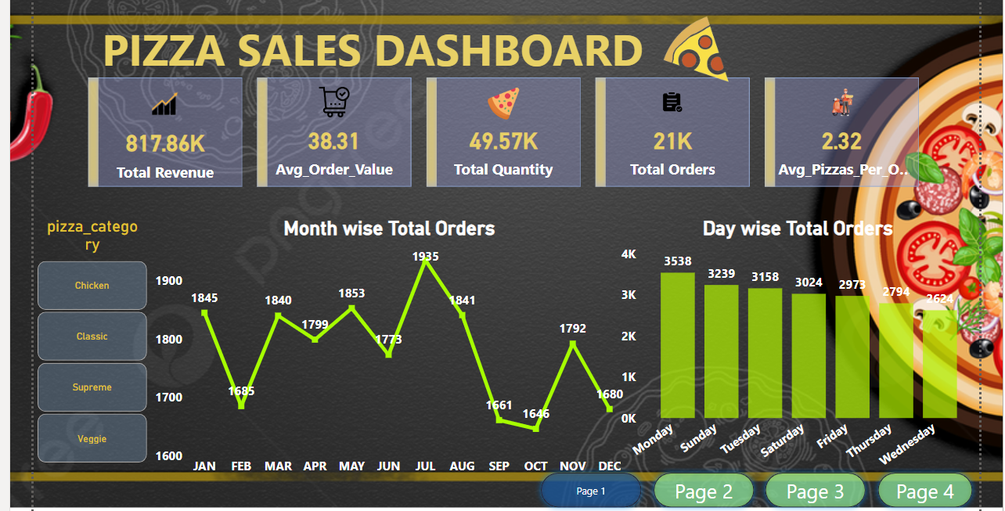
Data Visualization in POWER BI:

Slide 24
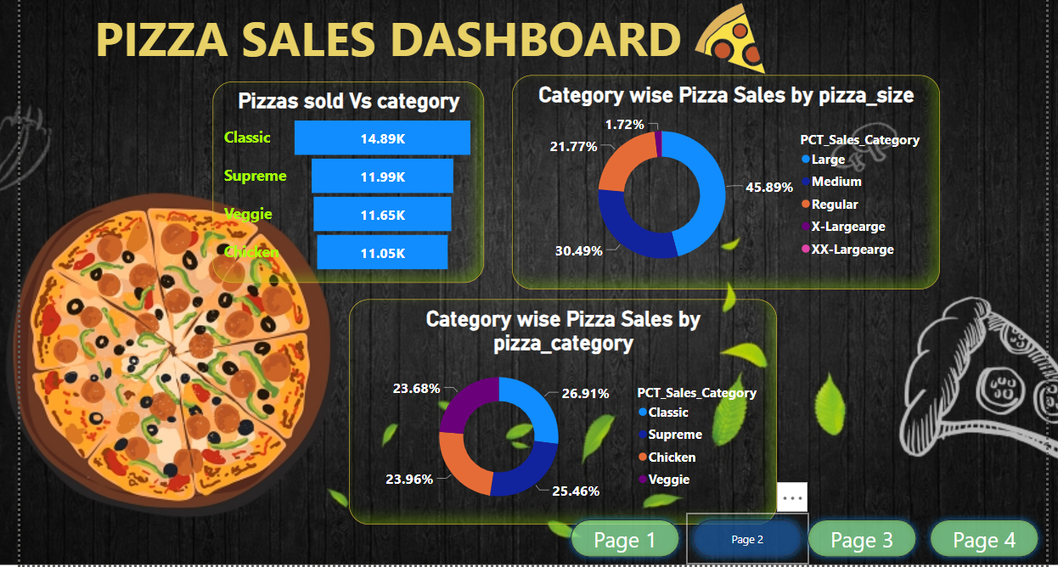
Data Visualization in POWER BI:

Slide 25
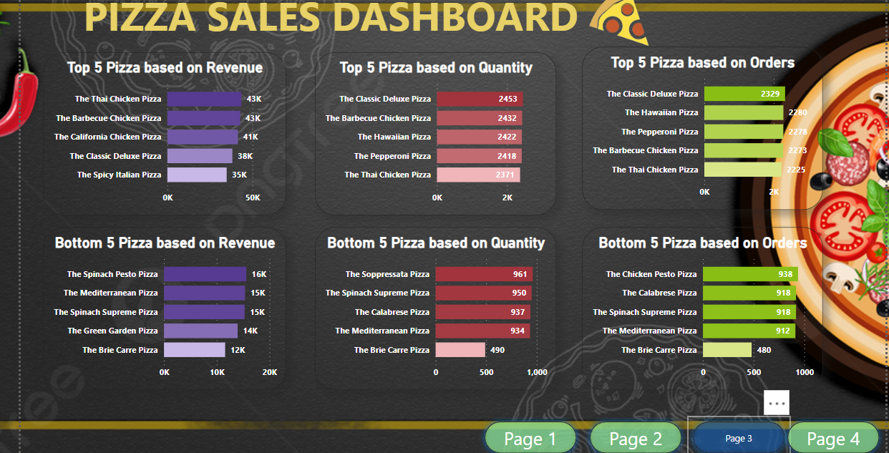
Data Visualization in POWER BI:

Slide 26
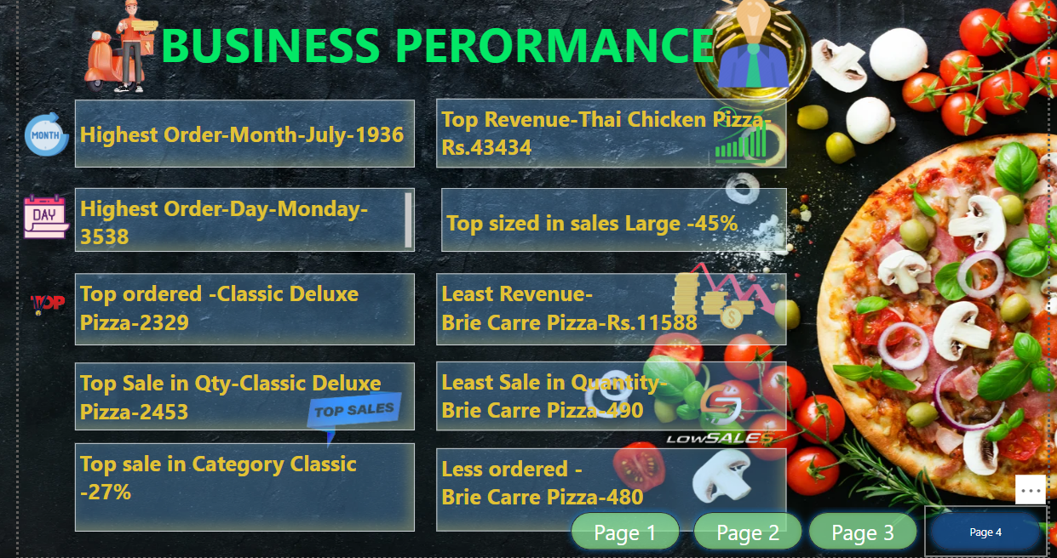
Insights to Organization:

